Slide 1
CS461 Proposal
Remote Unlocking System for Older Vehicles

Slide 2
Introduction: features at a high level
This project is designed to add remote unlocking, locking and keyless entry to older vehicles that do not have these features.
The main control unit should be able to detect your presence and automatically unlock the car when you are close.
The main control unit should be able to automatically lock the vehicle when the key is no longer detected (in case the user forgot to lock the doors)
Lastly, The key itself should be able to function as a normal key fob (i.e. unlock/lock car with the press of a button).

Slide 3
Competing projects

Slide 4
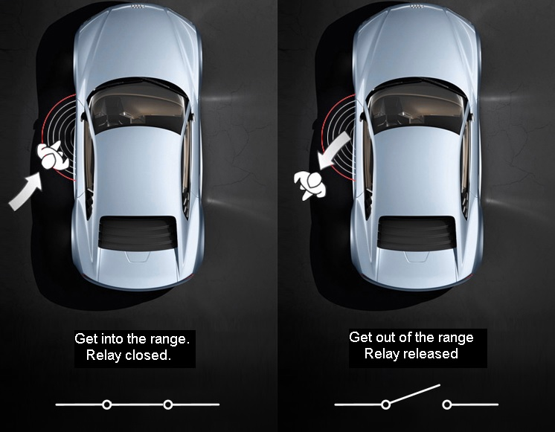
Open remote-keyless-system
Proximity remote entry system available on GitHub
Uses Bluetooth signal
Uses Arduino MC with external BT chip
Adapted to work with more modern chip

Slide 5
Hardware

Slide 6
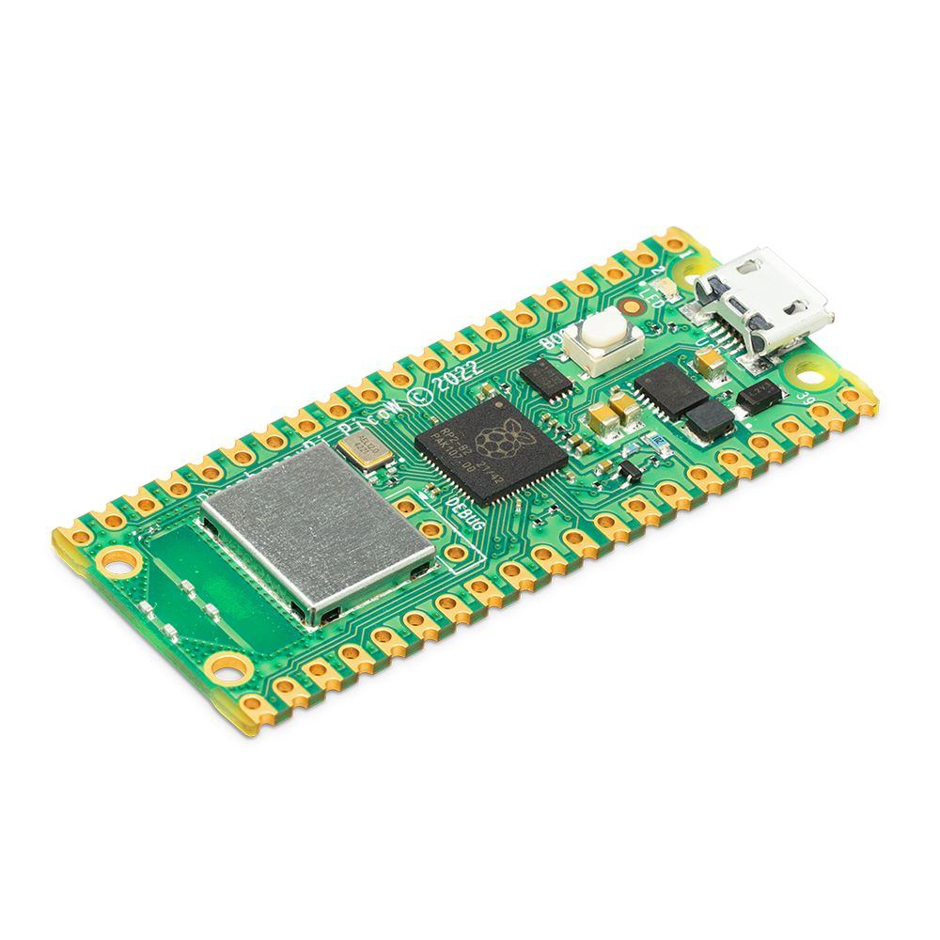
Raspberry Pi pico w
0.69 Watts Max Power Draw
32bit Dual core @ 133 MHz
264 KiB RAM / 2 MiB ROM
WiFi Only

Slide 7
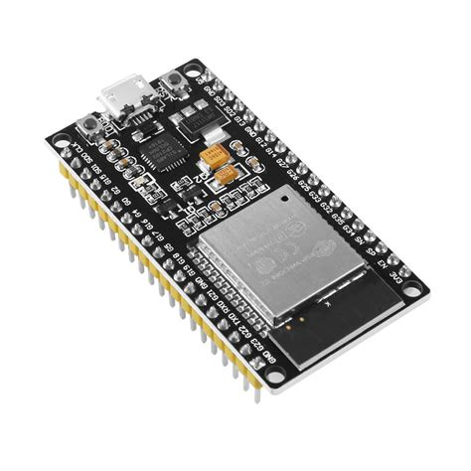
ESP32
0.83 Watts Max Power Draw
32bit Dual core @ 240 MHz
520KiB RAM / 488 KiB ROM
WiFi, BLE, ESP-NOW

Slide 8
Languages

Slide 9
Programming languages
C++
micropython
Built as an addon to C in 1985
Low level language
Moderate difficulty
Language of choice for most microcontrollers
“Boiled down” version of Python 3
Designed for microcontrollers
Easy to program with
Best support on the PyBoard or the Pico

Slide 10
Security

Slide 11
Rolling codes: an overview
Modern cars use a 40-bit rolling code
Key fob and car use same pseudo-random number generator
These number generators are “in sync” with each other
Receiver can accept the next 256 codes
Compensates for pressing button when car isn’t in range

Slide 12
Communication

Slide 13



Protocols: communication
ESP-NOW
BLe
wifi
ESP devices only
ESP32 and Pico W*
ESP32 and Pico W
*When Bluetooth support is added to the Pico W’s firmware

Slide 14
How I will use esp-now
Pseudo-Code here
Using ESP-NOW, 250 bits to work with
32-bit rolling code
64-bit system time
4 bits for action (lock, unlock)
Chose 4 bits to round up to 100
Plenty of room for all information

Slide 15
How I will use esp-now
Using ESP-NOW, 250 bits to work with
32-bit rolling code
64-bit system time
4 bits for action (lock, unlock)
Chose 4 bits to round up to 100
Plenty of room for all information

Slide 16
Range finding

Slide 17
Protocols: Range finding
Bluetooth rssi
Time traveled
Bluetooth RSSI is the signal strength measured in dBm
Not super accurate
Fairly simple to implement
Semi homebrew
Uses the time between transmit and receive
Can be pretty accurate
Both microcontrollers need to have a perfectly synchronized clock

Slide 18
Conclusion

Slide 19
What I will use for this project
C++ language
Rolling codes for security
32-bit code
ESP-NOW communication protocol
Bluetooth RSSI for range finding

